Slide 1
Summary for final exam
By:
Manal Anetallah Alsahafi
2021/2022

Slide 2
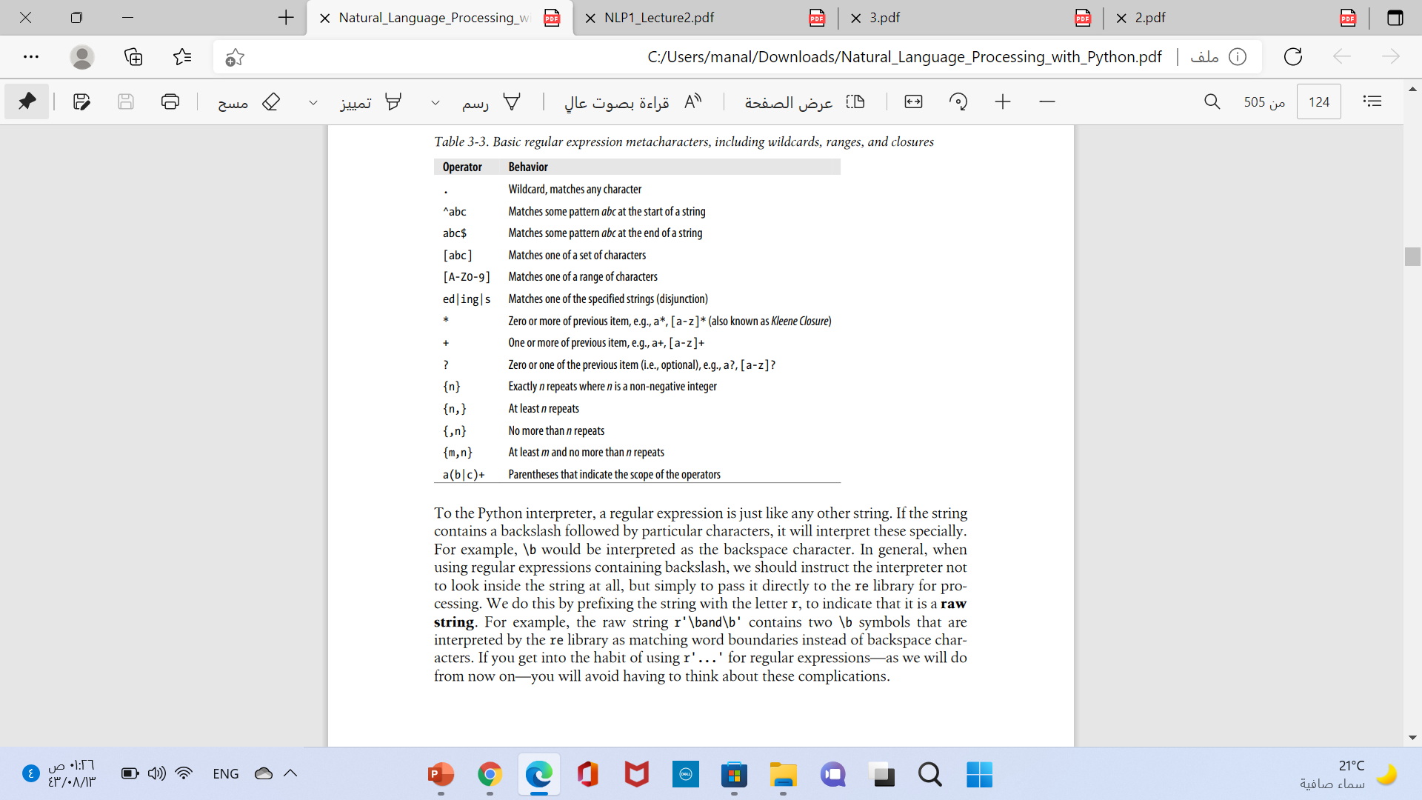

Slide 3
Complex Example
The user might want “any PC with more than 500 MHz and 32 Gb of disk space for less than $1000”.
First, let’s complete our regular expression for prices.
$999.99 X<$1000: /\b$[0-9]+(\.[0-9][0-9])?\b/
(5.5 GB) : /\b[0-9]+(\.[0-9]+)? *(Gb|[Gg]igabytes?)\b/
(32 Gb ):/\b[0-9]+ *(Gb|[Gg]igabytes?)\b/
(500 MHz):/\b[0-9]+ *(MHz|[Mm]egahertz|GHz|[Gg]igahertz)\b/
Patterns to specify operating systems:
/\b(Windows *(Vista|XP)?)
/\b/ /\b(Mac|Macintosh|Apple|OS X)\b/

Slide 4
Complex Example “The”
/[ˆa-zA-Z][tT]he[ˆa-zA-Z]/
it won’t find the word the when it begins a line
/(ˆ|[ˆa-zA-Z])[tT]he([ˆa-zA-Z]|$)/
We can avoid this by specifying that before the the we require either the beginning-of-line or a non-alphabetic character, and the same at the end of the line

Slide 5
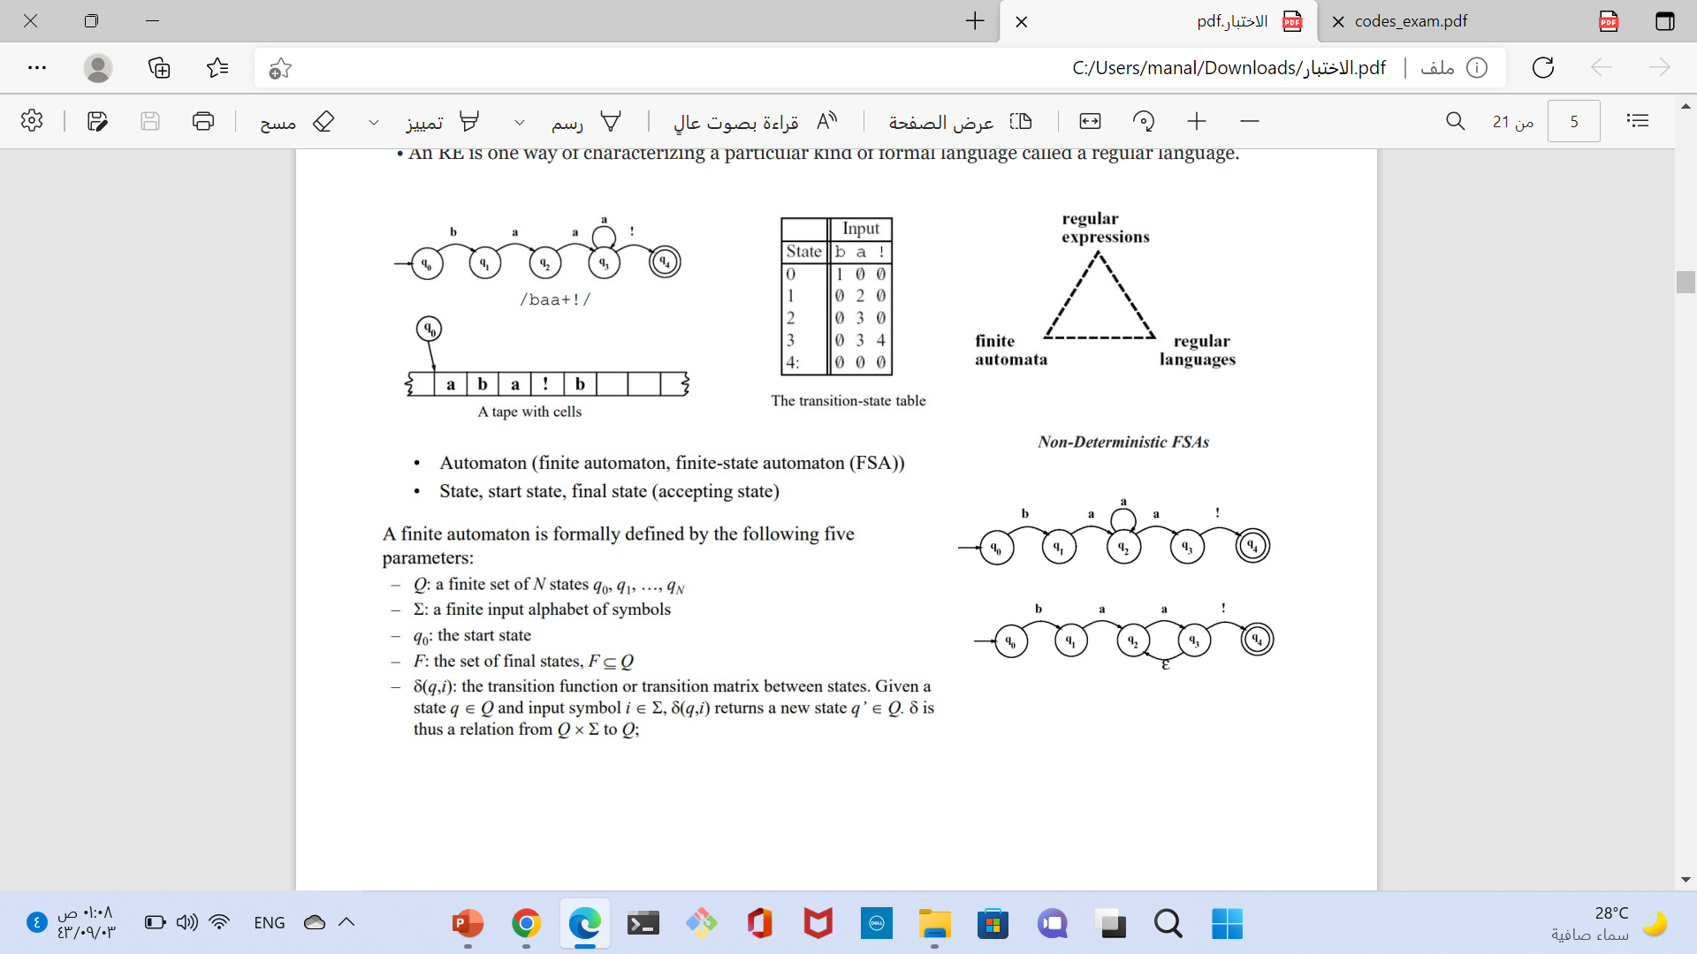
FSAs as Graphs
Let’s start with the sheep language
/baa+!/
We can say the following things about this machine
It has 5 states
b, a, and ! are in its alphabet
q₀ is the start state
q₄ is an accept state
It has 5 transitions
Formal Language: A model which can both generate and recognize all and only the strings of a formal language acts as a definition of the formal language
L(m) = {baa!,baaa!,baaaa!,baaaaa!,baaaaaa!,...}

Slide 6
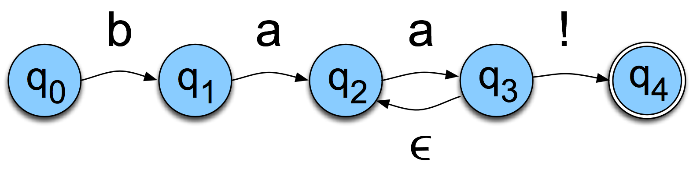
Non-Determinism cont.
Yet another technique
Epsilon transitions
If we are in state 3, we are allowed to move to state 2 without looking at the input, or advancing our input pointer. So this introduces another kind of non-determinism — we might not know whether to follow the ǫ-transition or the ! arc

Slide 7
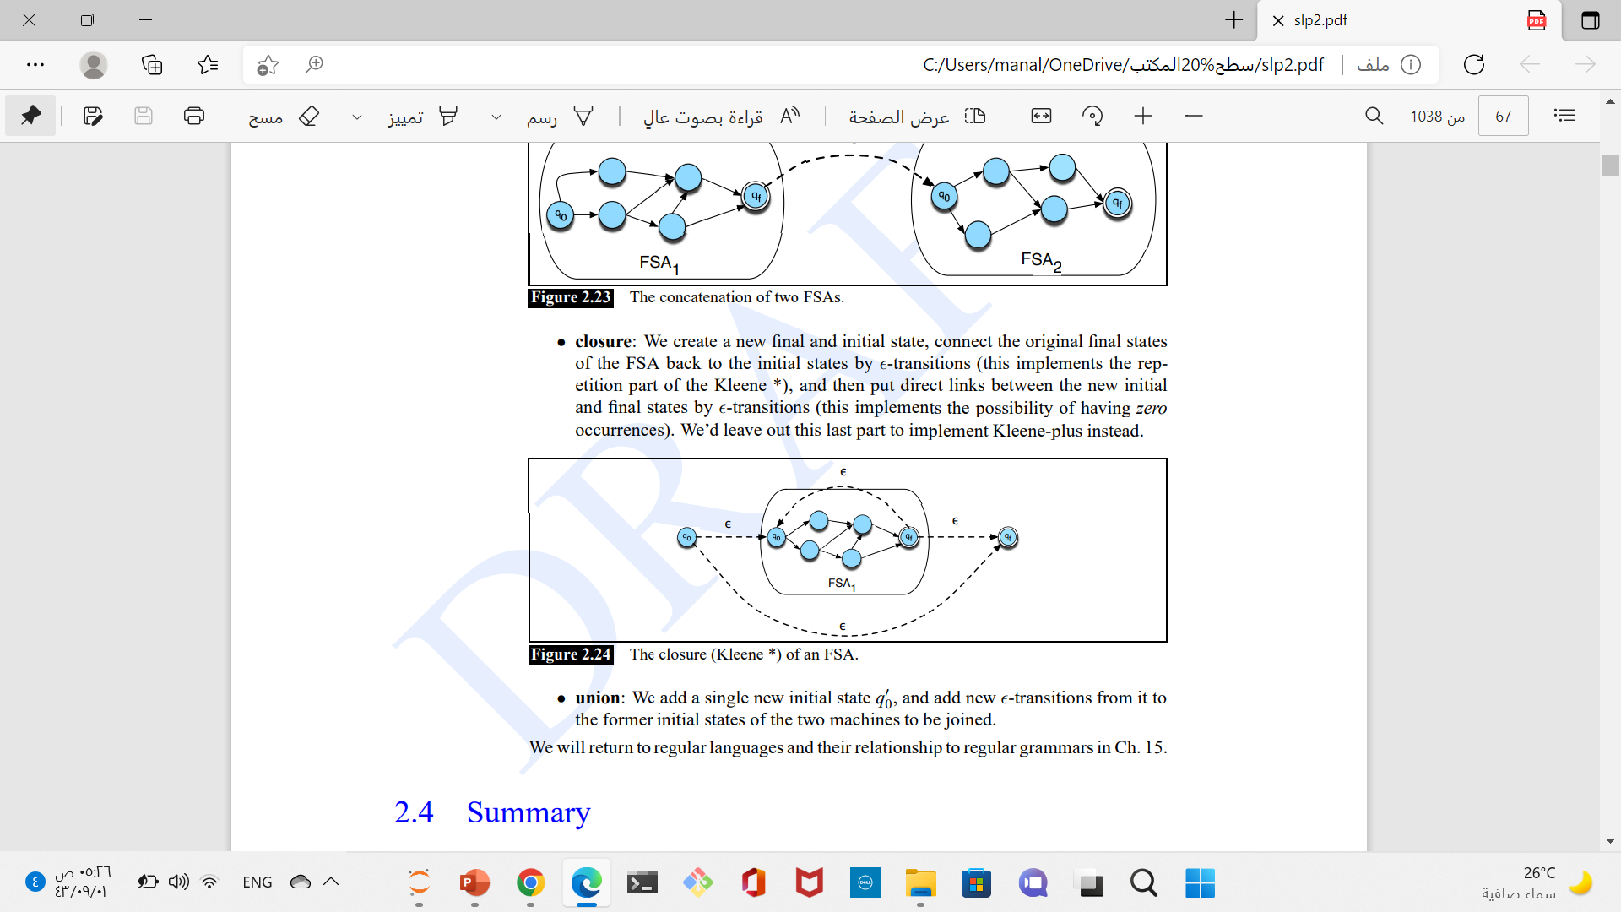
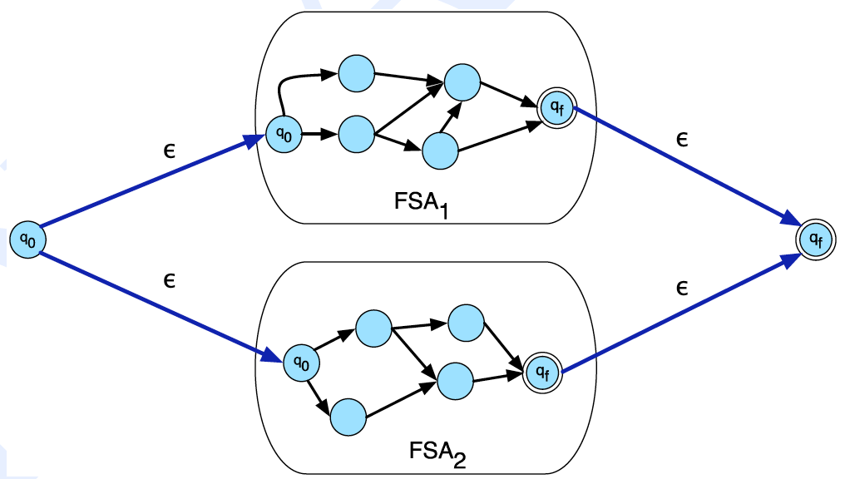
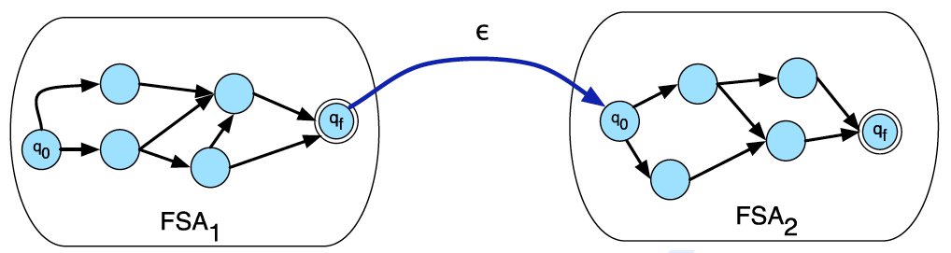
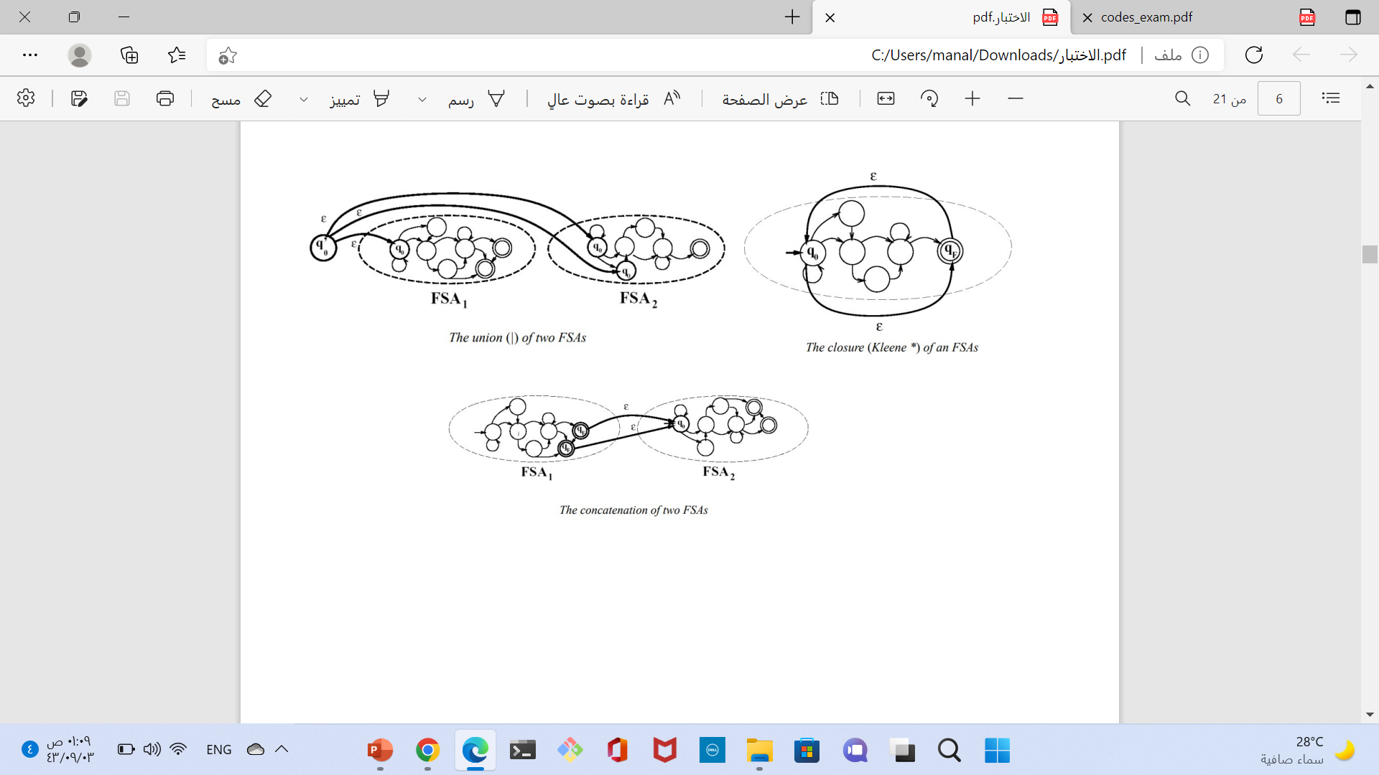
Union

Slide 8
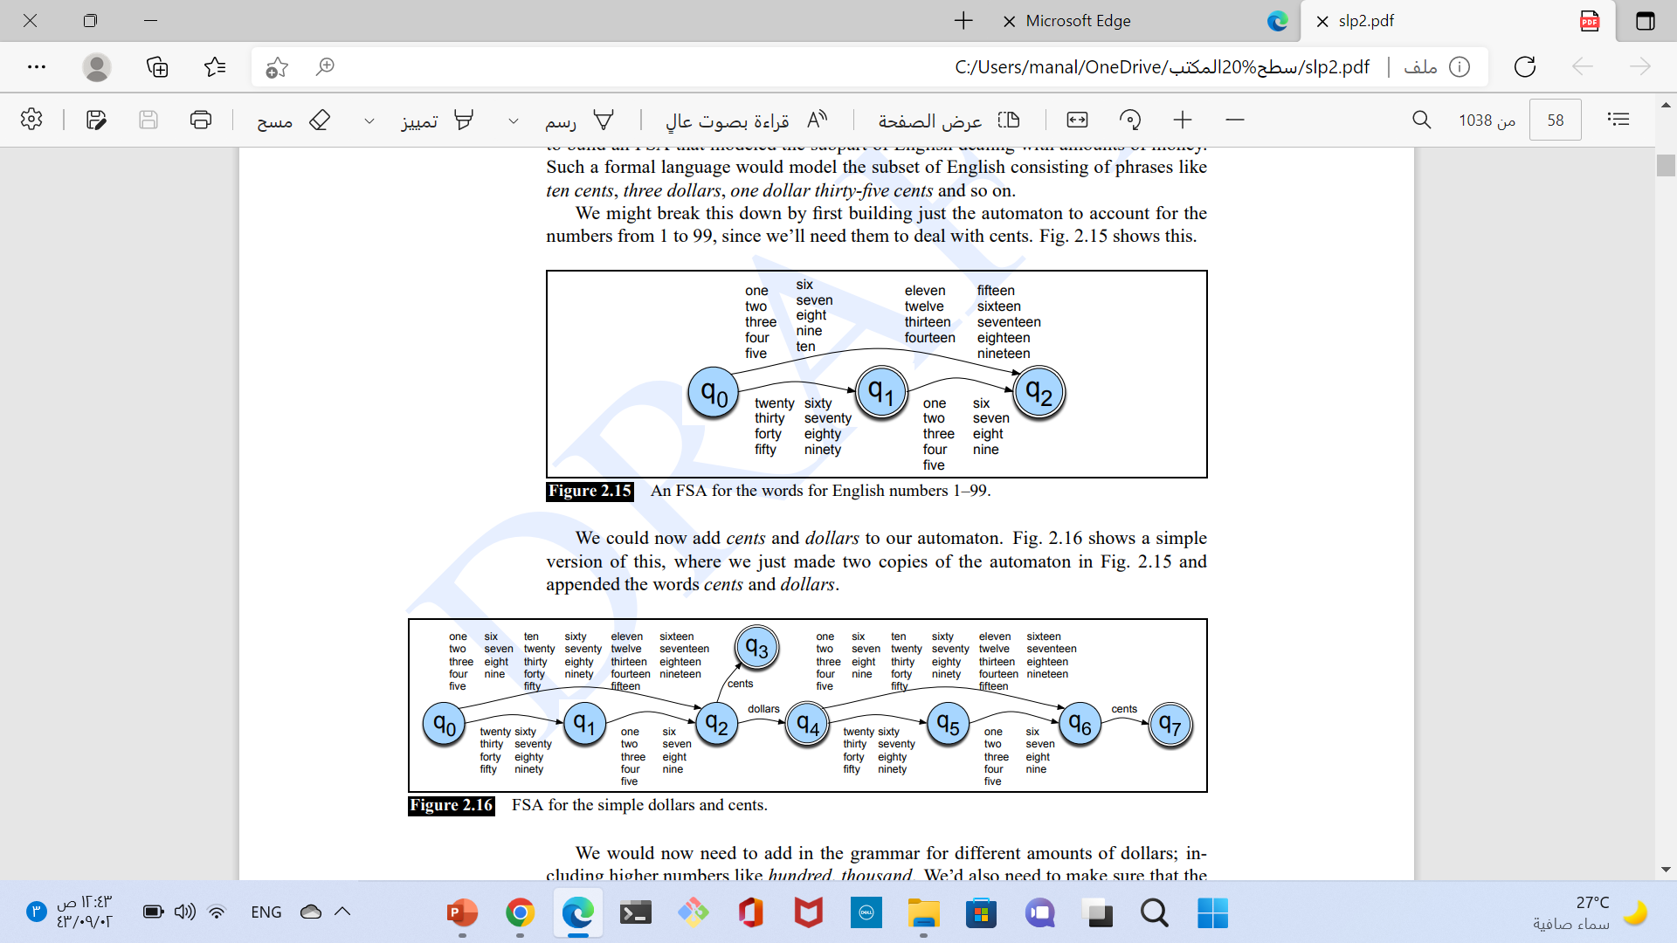
Exercise
Complete the FSA for English money expressions in Fig. 2.15 as suggested in the text following the figure.
You should handle amounts up to $100,000, and make sure that cents and dollars are singular when appropriate (one cent, one dollar), and plural when appropriate (ten cents, two dollars).

Slide 9
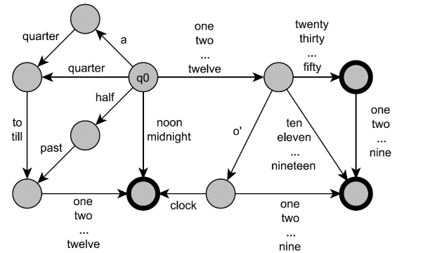
Exercise
Write an FSA for time-of-day expressions like eleven o’clock, twelve-thirty, midnight, or a quarter to ten and others.

Slide 10
Choose the best answer:
To build a NLP program that being able to reply to humans using polite, kind and indirect language, requires knowledge of………………
a) Phonology
b) Pragmatics
c) Morphology
Write regular expressions for the following languages:
a) The set of all strings from the alphabet a; b such that each a is immediately preceded and immediately followed by a b.
b) All strings that start at the beginning of the line with an integer and that end at the end of the line with a word.
Answer of Question Two:
(𝐛 + (𝐚𝐛+)+)?
ˆ\𝐝+\𝐛.∗\𝐛[𝐚− 𝐳𝐀 − 𝐙] + $

Slide 11
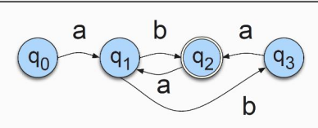
Homwork
Write a regular expression for the language accepted by the NFSA in the following figure:
(𝐚𝐛𝐚? )+

Slide 12
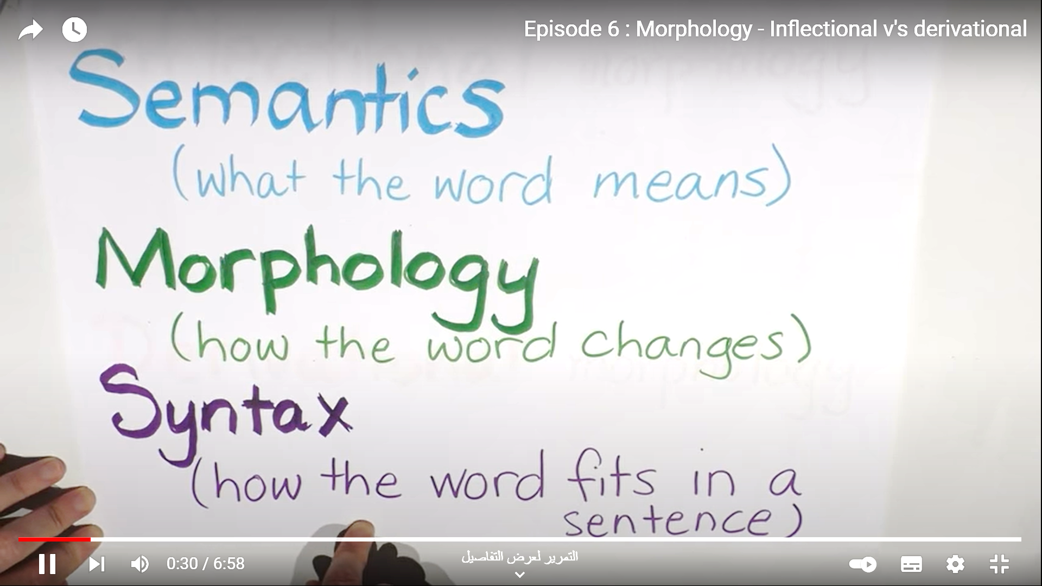
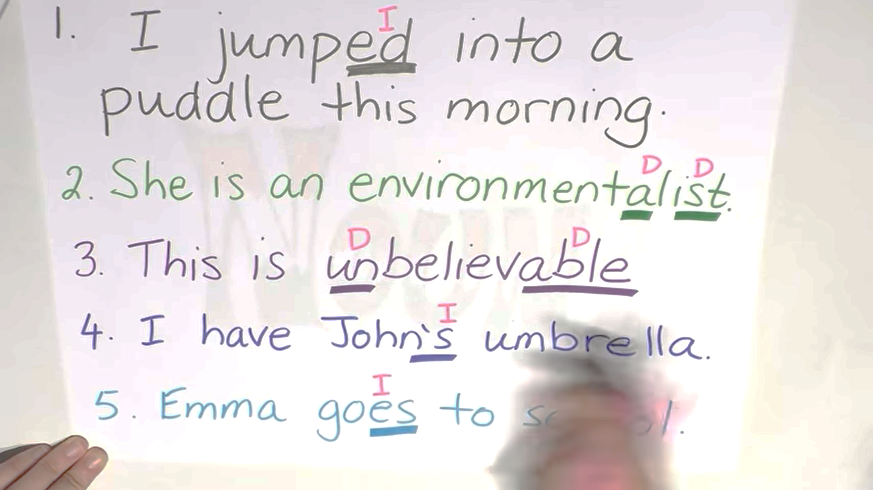
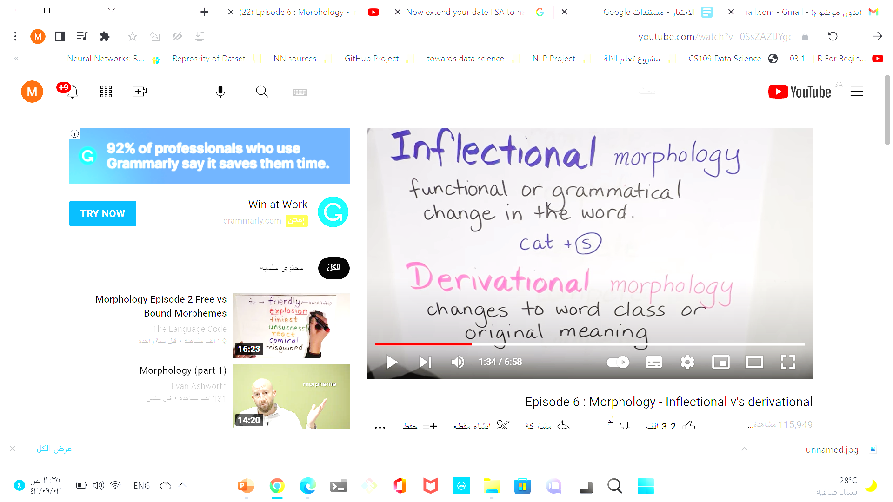
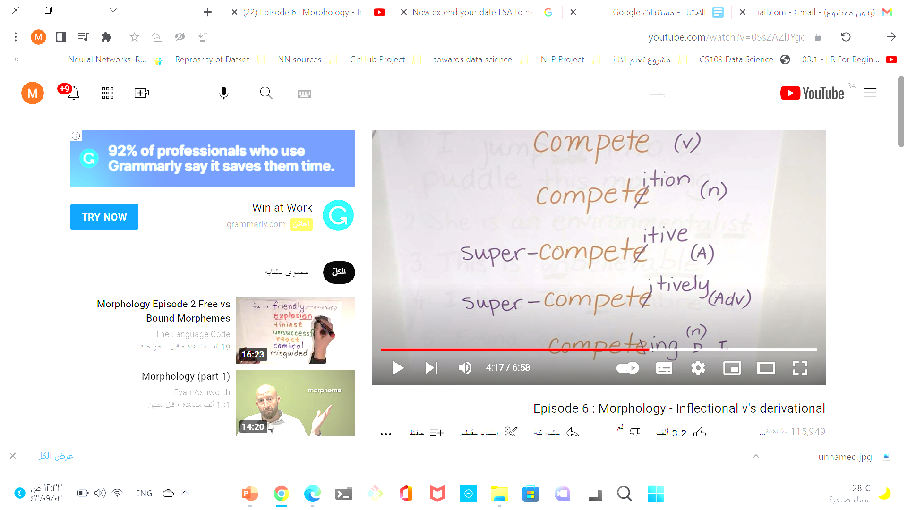
Example determine what the Inflectional and what is the Derivational

Slide 13
Morphology
Morphological analysis is an important task in NLP, the goal is to reduce words to their basic form.
There are two possible ways of doing this:
Stemming: Reducing words to a base based on rules, not a dictionary (Not a real word but more like a prefix)
Lemmatization: Removing inflectional endings only and returning the base dictionary form of a word which is also known as a lemma.
(produces a real word from a dictionary)

Slide 14
Morphology
Morphology and Morphological parsing: Breaking down words into smaller meaningful units (morphemes) and building a structured representation.
Morphemes contain to parts:
Stems: The core meaning-bearing units
Affixes: Parts that adhere to stems, often with grammatical functions
Affixes are further divided into prefixes, suffixes, infixes, and circumfixes.
Suffix: eat-s
Prefix: un-buckle
Circumfix: ge-sag-t (said) sagen (to say) (in German)
Infix: hingi (borrow) humingi
Morphological Parsers:
Parse cats into two morphemes cat and s

Slide 15
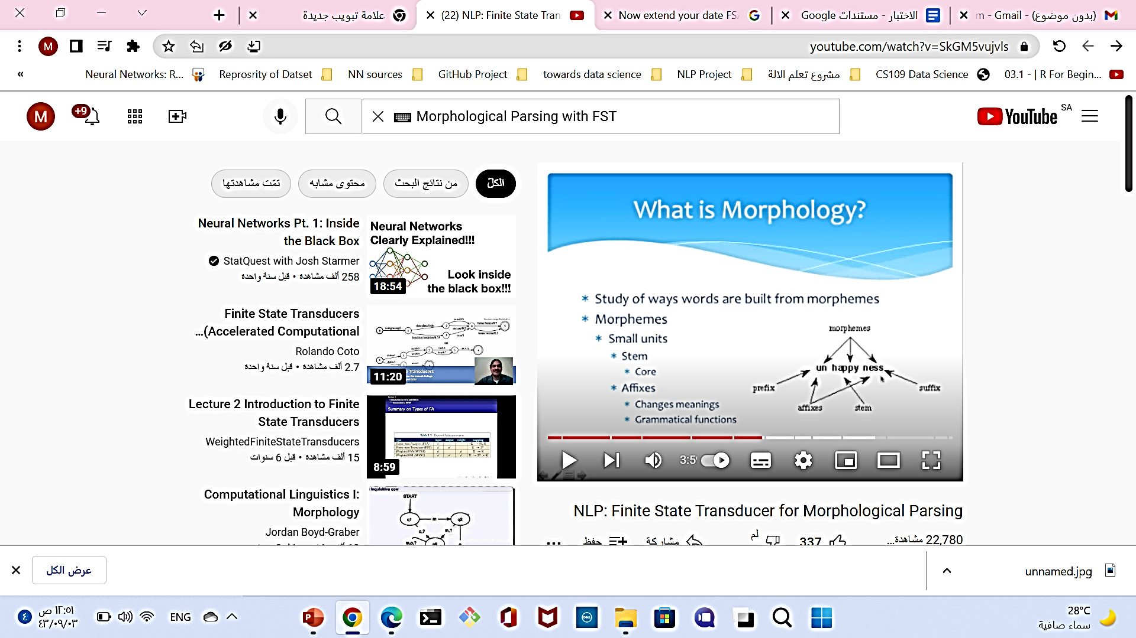
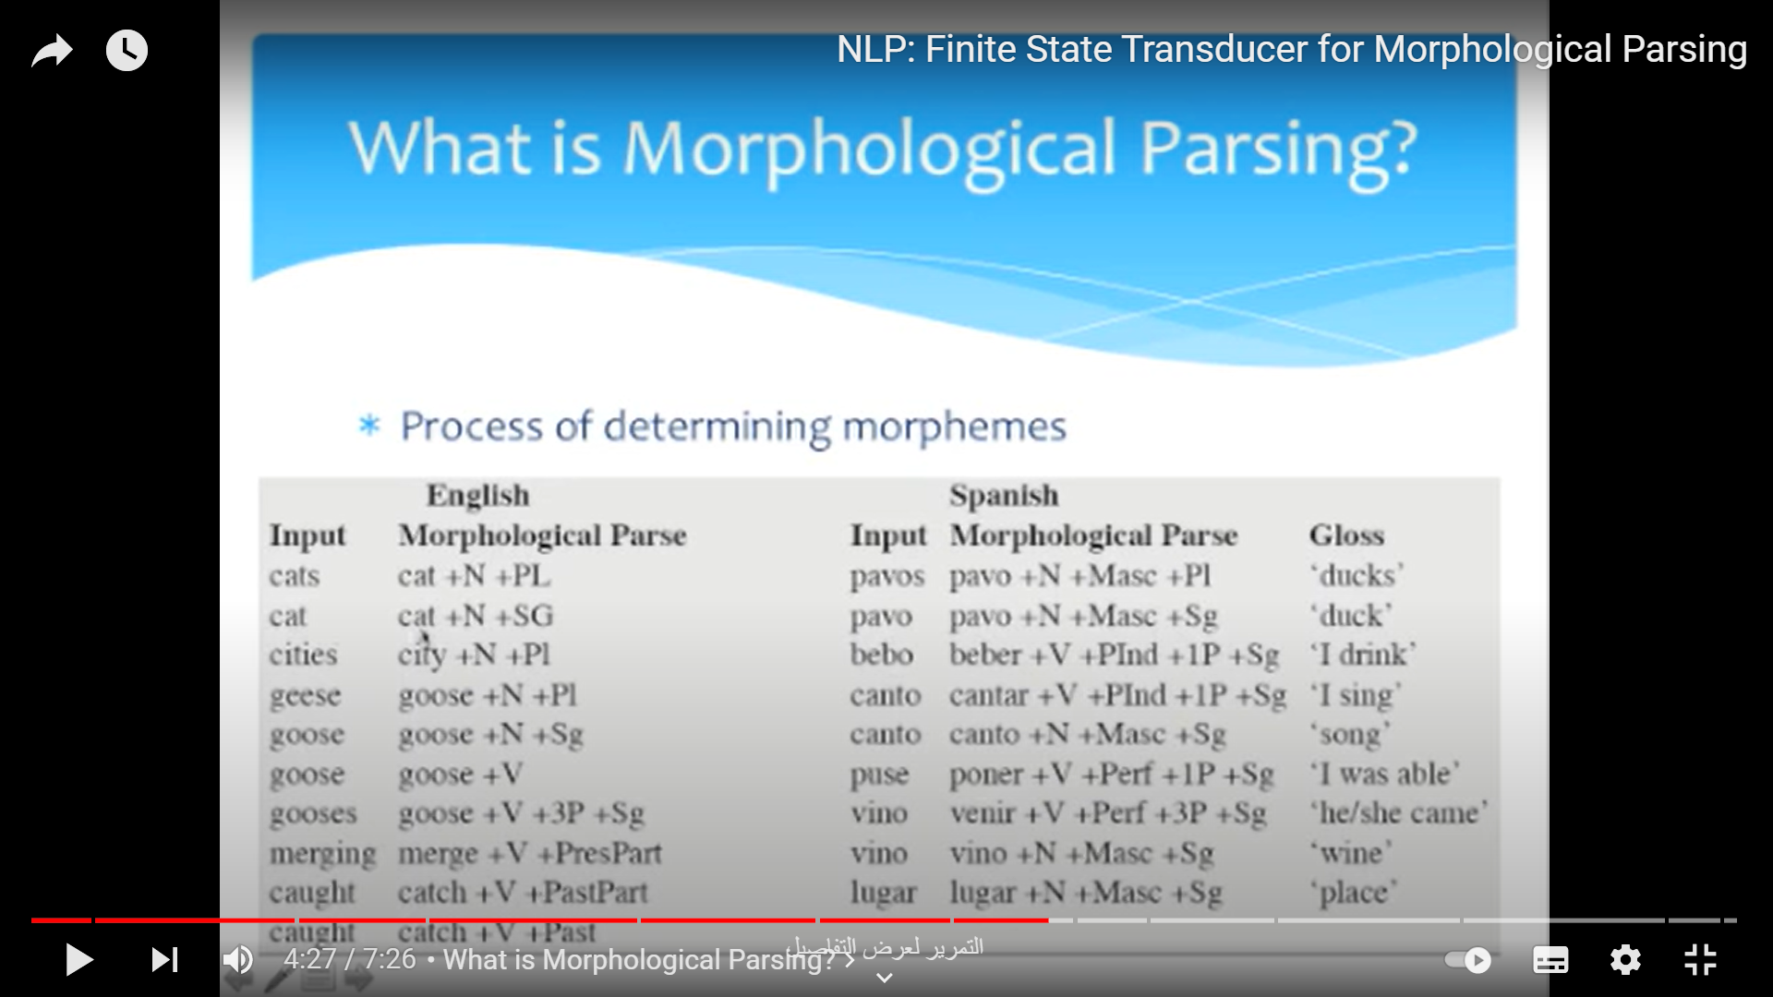
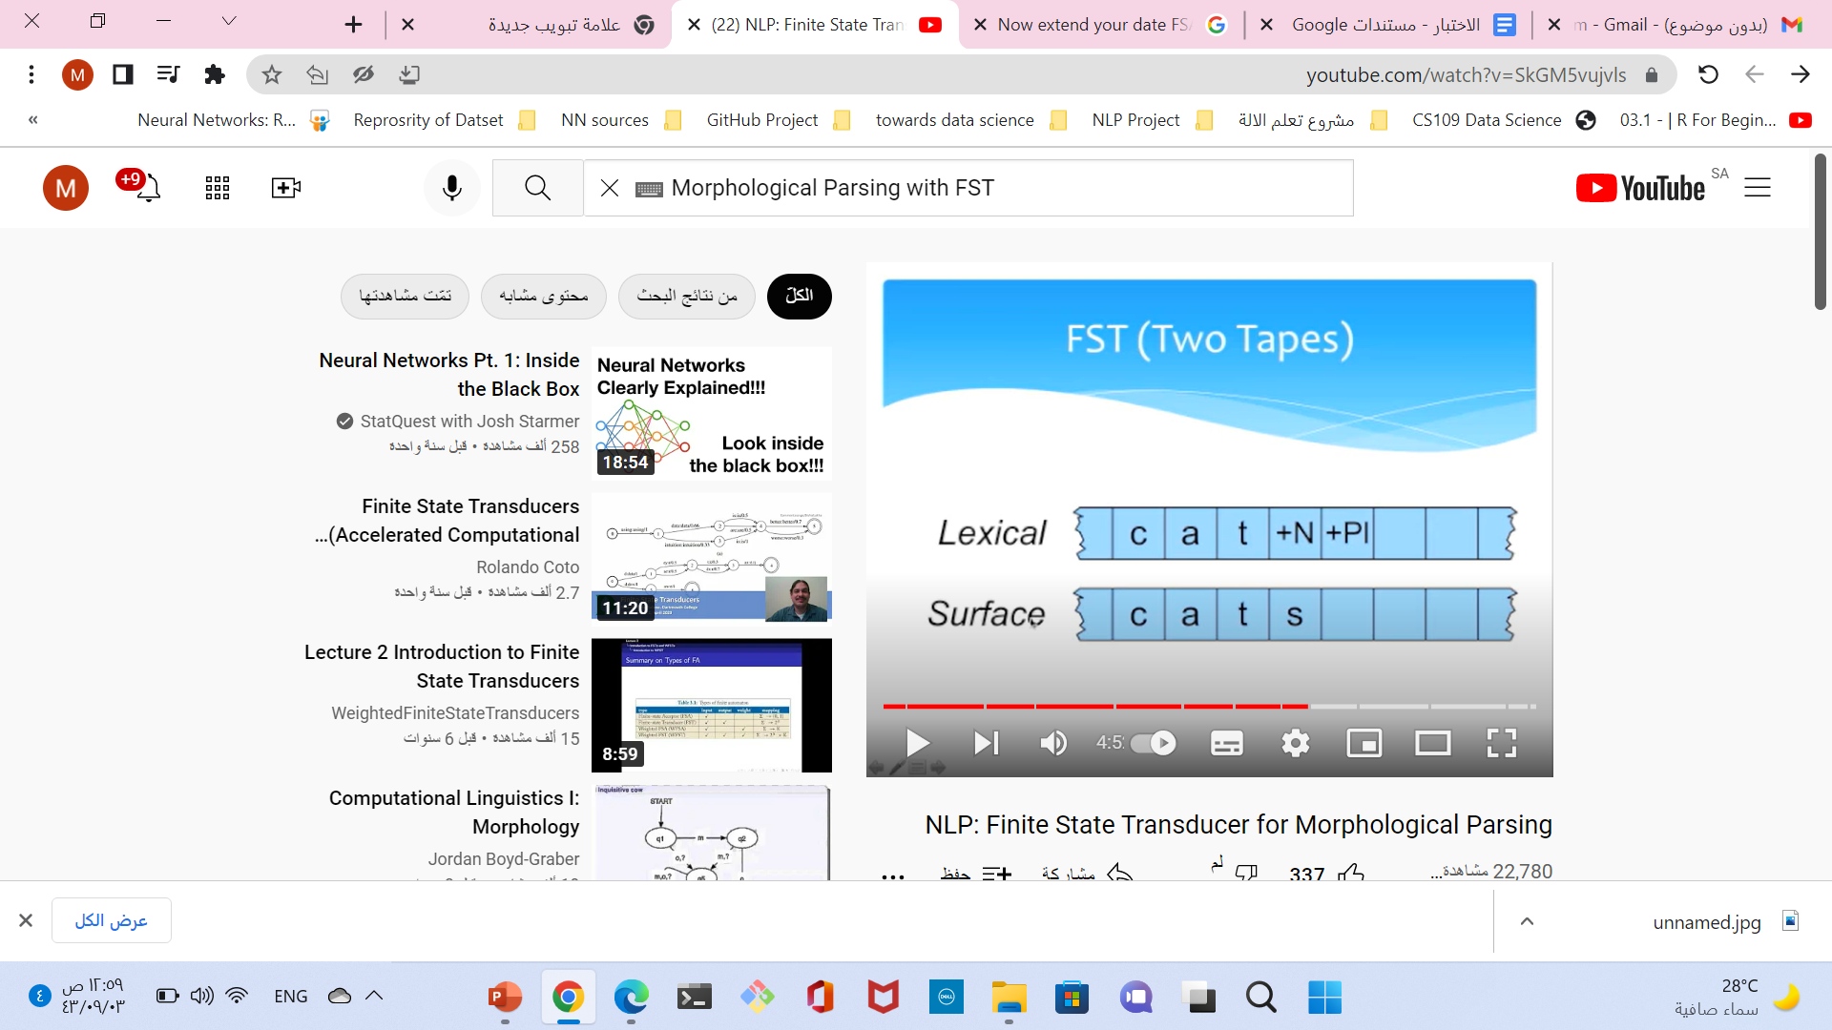
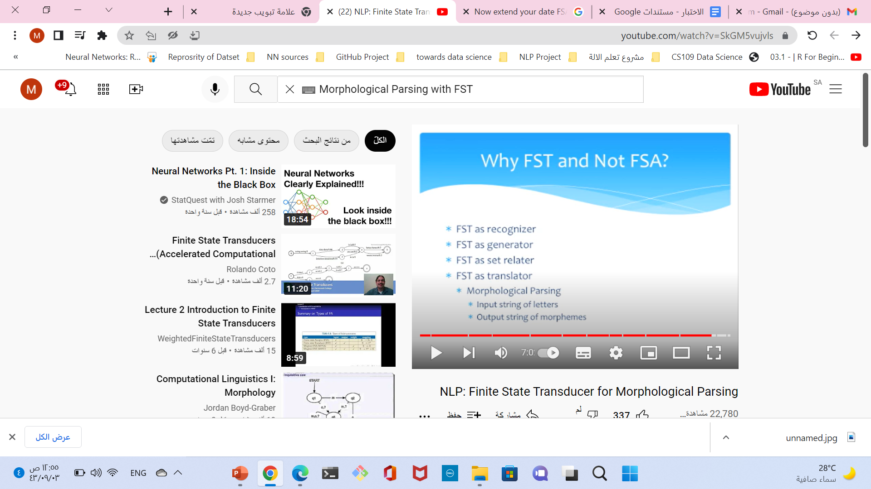

Slide 16
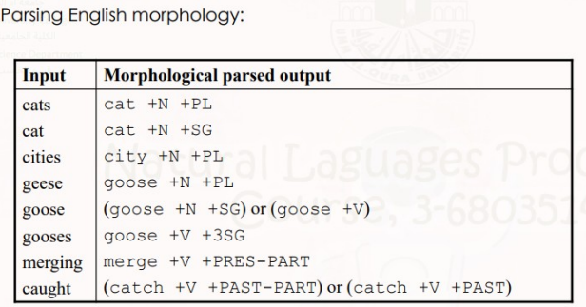
Finite-State Morphological Parsing
To build a morphological parser:
Lexicon: List of stems and affixes, together with basic information about them
Morphotactics: Model of morpheme ordering that explains which classes of morphemes can follow other classes of morphemes inside a word. E.g., the rule that English plural morpheme follows the noun rather than preceding it.
Orthographic rules: these spelling rules are used to model the changes that occur in a word, usually when two morphemes combine (e.g., the y→ie spelling rule changes city + -s to cities).

Slide 17
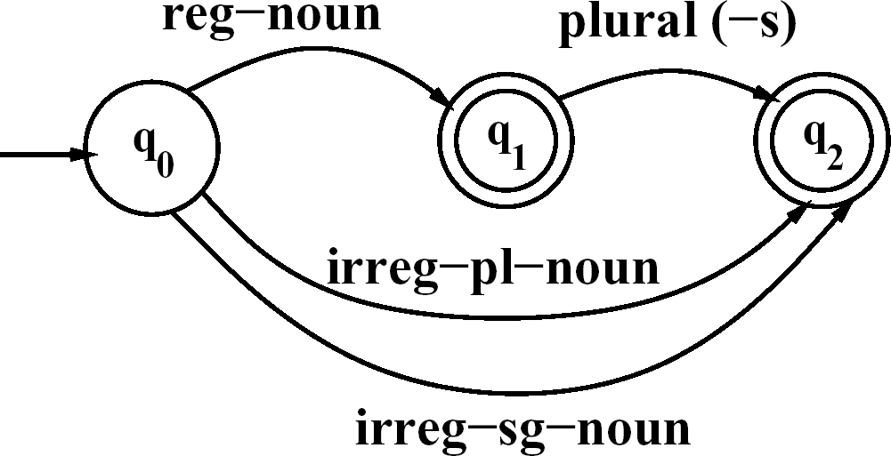
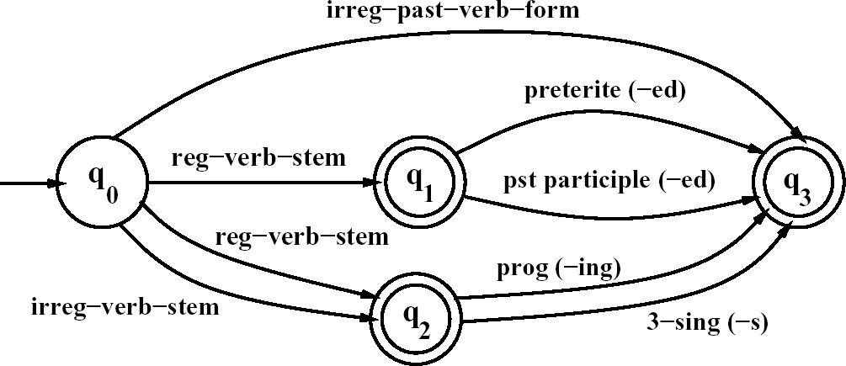
Finite-State Morphological Parsing (LIST + MODEL)
An FSA for English nominal inflection
Reg-noun | Irreg-pl-noun | Irreg-sg-noun | plural
fox fat fog fardvark | geese sheep Mice | goose sheep mouse | -s
An FSA for English verbal inflection
Reg-verb-stem | Irreg-verb-stem | Irreg-past-verb | past | Past-part | Pres-part | 3sg
walk fry talk impeach | cut speak sing sang spoken | caught ate eaten | -ed | -ed | -ing | -s

Slide 18
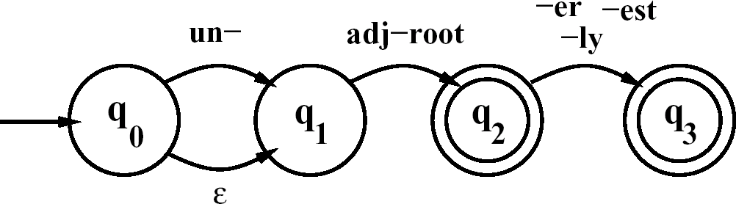
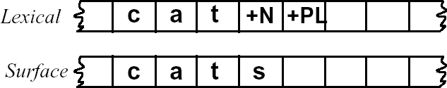
Finite-State Morphological Parsing
An FSA for a fragment of English adjective Morphology #1
big, bigger, biggest
cool, cooler, coolest, coolly red, redder, reddest
clear, clearer, clearest, clearly, unclear, unclearly happy, happier, happiest, happily
unhappy, unhappier, unhappiest, unhappily real, unreal, really
Two-level morphology FST:
lexical level: representing a word as a correspondence
surface level: Representing the actual spelling of the final word.

Slide 19
Morphological Parsing with FST
FST is a type of FSA which maps between two sets of symbols. It is a two-tape automaton that recognizes or generates pairs of strings, one from each type.
FST defines relations between sets of strings Finite-state transducers for NLP :
● FST as recognizer – Takes a pair of strings and accepts or rejects them
● FST as generator – Outputs a pair of strings for a language
● FST as translator – Reads a string and outputs another string – Morphological parsing: letters (input); morphemes (output)
● FST as relater – Computes relations between sets

Slide 20
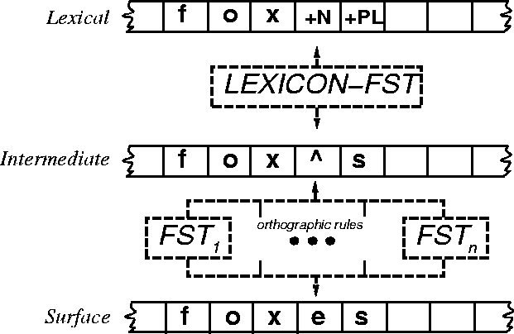
Combining FST Lexicon and Rules
Parsing can be slightly more complicated than a generation, because of the problem of ambiguity.
For example, foxes could be fox +V +3SG as well as fox +N +PL

Slide 21
Porter Stemmer
Information retrieval
One of the most widely used stemming algorithms is the simple and efficient Porter algorithm, which is based on a series of simple cascaded rewrite rules.
Problem:
Not perfect: error ( commision > omission)

Slide 22
Tokenization
Tokenization or word segmentation separate out “words” (lexical entries) from running text expand abbreviated terms
Tokenization is usually performed before, or as part of, the tagging process, separating commas, quotation marks, etc., from words, and disambiguating end-of-sentence punctuation

Slide 23
POS
Tagging: The process of assigning a POS or lexical class to each word in a collection.
Tags: symbols like(N, V, ADJ, ADV, P, PRO, DET……)
Tagger: a mechanism that computer used to tag word after tokenization
Called: parts-of-speech, lexical categories, word classes, morphological classes, lexical tags
The primary target of POS tagging is to identify the grammatical group of a given word: whether it is a noun, pronoun, adjective, verb, adverbs, etc. based on the context.
POS tagging improves accuracy
Feed POS tags to the Lemmatizer
For example, the word ‘leaves’ without a POS tag would get lemmatized to the word ‘leaf’, but with a verb tag, its lemma would become ‘leave’.

Slide 24
POS Tagging Choosing a Tagset
To do POS tagging, we need to choose a standard set of tags to work with
Could pick very coarse tagsets
N, V, Adj, Adv.
More commonly used set
Small= 45 (Penn TreeBank ) tagset
Medium =87 (Brown) tagset
Large =146 for (C7 ) tagset

Slide 25
Open class ("content") words
Nouns
Verbs
Adjectives
old green tasty
Proper
Common
Main
Adverbs
slowly yesterday
Janet
Italy
cat, cats
mango
eat
went
Interjections
Ow hello
Numbers
… more
122,312
one
Closed class ("function")
Auxiliary
Determiners
the some
can
had
Prepositions
to with
Conjunctions
and or
Particles
off up
… more
Pronouns
they its
Notes:
Nouns are words for people, places, or things, but include others as well. Common nouns include concrete terms like cat and mango, abstractions like algorithm and beauty, and verb-like terms like pacing as in His pacing to and fro became quite annoying.
Verbs refer to actions and processes, including open-class main verbs like draw, provide, and go. and closed-class auxiliary verbs like "can", "will", "had" Auxiliary verbs can mark semantic features of a main verb such as its tense, aspect, or made.
Adjectives often describe properties or qualities of nouns, like color (white, black), age (old, young), and value (good, bad)
Other closed class or function words include Pronouns act as a shorthand for referring to an entity or event, or
conjunctions that join two phrases, clauses, or sentences, including Coordinating conjunc- tions like and, or, and but, or subordinating conjunctions like that in “I thought that you might like some milk” that links "the verb thought" with the clause "you might like some milk".

Slide 26
POS tagging is one disambiguation
Ambiguous When there is more than one possible usage and part-of-speech.
It turns out that most words in English are unambiguous; i.e., they have only a single tag. But many of the most common words in English are ambiguous
How to choose the proper tag for the context????
Use one method :
Rule-based tagging
Stochastic-based tagging
Transformation-based tagging

Slide 27
Methods for POS Tagging
Rule-based tagging
(ENGTWOL)
large database of handwritten disambiguation rules (if-then-else)
Start With a Dictionary
Assign Every Possible Tag
Write Rules to Eliminate Tags
Stochastic
Probabilistic sequence models
HMM (Hidden Markov Model) tagging
using a training corpus to compute the probability of a given word having a given tag in a given context
3. Transformation-based tagger or the Brill tagger
shares features of both tagging architectures
allows having linguistic knowledge in a readable form, transforms one state to another state by using transformation rules.

Slide 28
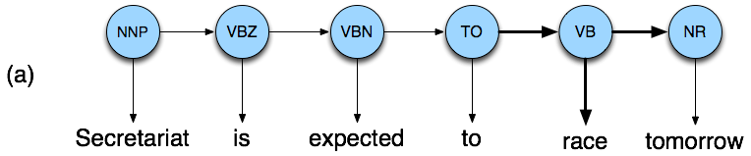

Disambiguating “race” Example
Secretariat/NNP is/VBZ expected/VBN to/TO race/VB tomorrow/NR
People/NNS continue/VB to/TO inquire/VB the/DT reason/NN for/IN the/DT race/NN for/IN outer/JJ space/NN
How do we pick the right tag?

Slide 29
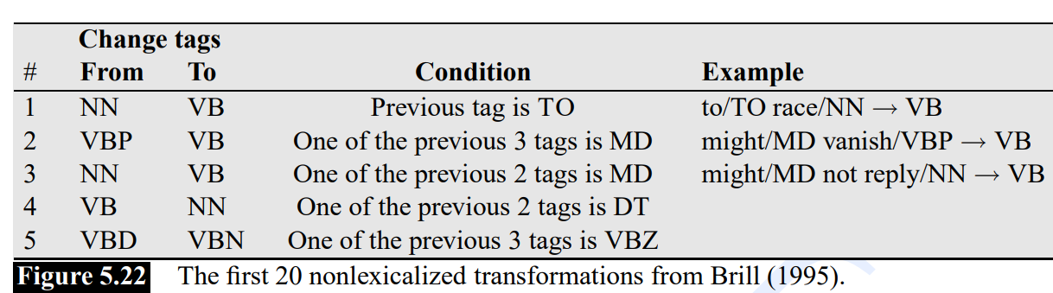
TransformationBased Brill

Slide 30
Disambiguating “race” Example
Brown corpus gives us the following probabilities, showing that verbs are about 500 times as likely as nouns to occur after TO:
P(NN|TO) = .00047
P(VB|TO) = .83
Here are the lexical likelihoods from Brown:
P(race|NN) = .00057
P(race|VB) = .00012
Finally, we need to represent the tag sequence probability for the following tag
P(NR|VB) = .0027
P(NR|NN) = .0012
multiply the lexical likelihoods with the tag sequence probabilities
P(VB|TO)P(NR|VB)P(race|VB) = .00000027
P(NN|TO)P(NR|NN)P(race|NN)=.00000000032
So we (correctly) choose the verb

Slide 31
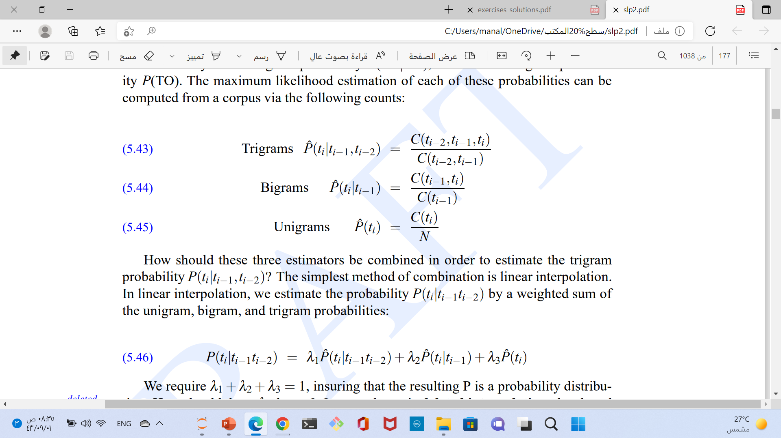
Stochastic Hidden Markov Models HMM
Markov chains can’t represent inherently ambiguous problems
Useful for assigning probabilities to unambiguous sequences
probability (word count/total number of words)

Slide 32
Probabilistic Language Modeling
Goal: compute the probability of a sentence or sequence of words:
P(W) = P(w₁,w₂,w₃,w₄,w₅…w_{n})
Related task: probability of an upcoming word:
P(w₅|w₁,w₂,w₃,w₄)
A model that computes either of these:
P(W) or P(w_{n}|w₁,w₂…w_{n-1}) is called a language model.
Better: the grammar But language model or LM is standard

Slide 33
N-grams
Simplest model that assigns probabilities to sentences and sequences of words, the n-gram of n words
Counts of N-grams to assess the conditional probability of candidate words(word1) as the next word (word2) in a sequence.
P(w_{n}|w₁,w₂…w_{n-1})
How to compute this joint probability:
P(its, water, is, so, transparent, that)
Rely on the Chain Rule of Probability

Slide 34
The Chain Rule applied to compute joint probability of words in sentence
P(A,B,C,D) = P(A)P(B|A)P(C|A,B)P(D|A,B,C)
P(its water was so transparent)=
P(its)*
P(water|its)*
P(was|its water)*
P(so|its water was)*
P(transparent|its water was so)
We’ll never see enough data for estimating these

Slide 35
Markov Assumption
Simplifying assumption:
Or maybe
Bigram version

Slide 36
Estimating bigram probabilities
The Maximum Likelihood Estimate(MLE)
compute the count of the bigram C(wn−1wn) and normalize by the sum of all the bigrams that share the same first word wn−1( prefix or previous word )
first need to augment each sentence with a special symbol
<s>at the beginning of the sentence, also need a special end-symbol. </s>

Slide 37
Example (MLE)
<s> I want english food </s>
P(i|<s>) = 0.25 P(english|want) = 0.0011
P(food|english) = 0.5 P(</s>|food) = 0.68
P(<s> i want english food </s>)
= P(i|<s>)P(want|i)P(english|want)
P(food|english)P(</s>|food)
= .25×.33×.0011×0.5×0.68
= .000031

Slide 38
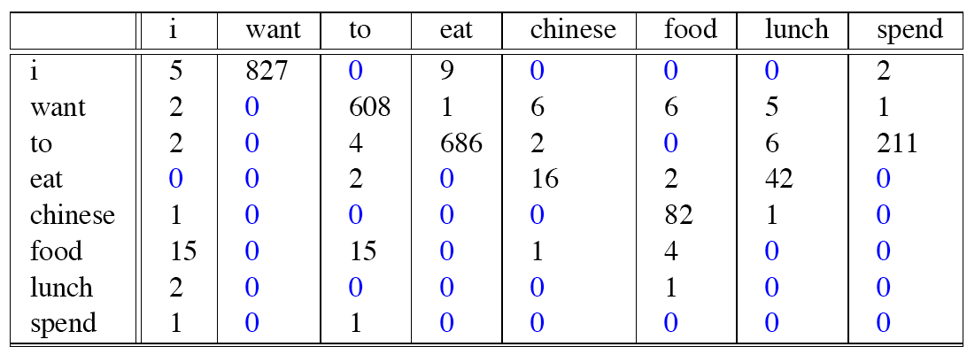
Bigram Probabilities
P(A,B,C,D) = P(A)P(B|A)P(C|A,B)P(D|A,B,C)
Get a unigram for each cell by dividing by the length of vocabulary
Dived each cell by the appropriate unigram for its row

Slide 39
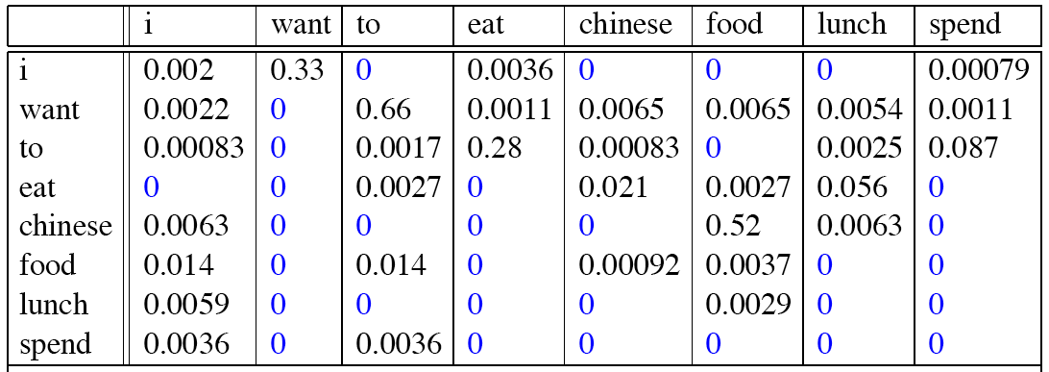
Result

Slide 40
Unknown Words
Problem of words whose bigram probability is zero. But what about words we simply have never seen before?
a closed vocabulary system the test set can closed vocabulary only contain words from this lexicon, and there will be no unknown words.
we have a pronunciation dictionary or a phrase table that is fixed in advance, and so the language model can only use the words in that dictionary or phrase table

Slide 41
Smoothing or discounting
To keep a language model from assigning zero probability to these unseen events, we’ll have to shave off a bit of probability mass from some more frequent events and give it to the events we’ve never seen.
There are variety of ways to do smoothing:
Good-Turing
Katz backoff
Witten-Bell
Is to use the count of things we’ve seen once to help estimate the count of things we’ve never seen

Slide 42
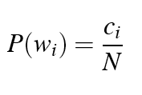
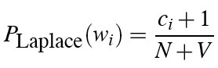
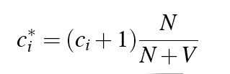
Laplace Smoothing (add-one )
V: the number of total words in the vocabulary
N: the total number of word tokens
Wi: The word
Ci: the count of the word
MLE estimate:
Laplace estimate:
Reconstructed counts:

Slide 43
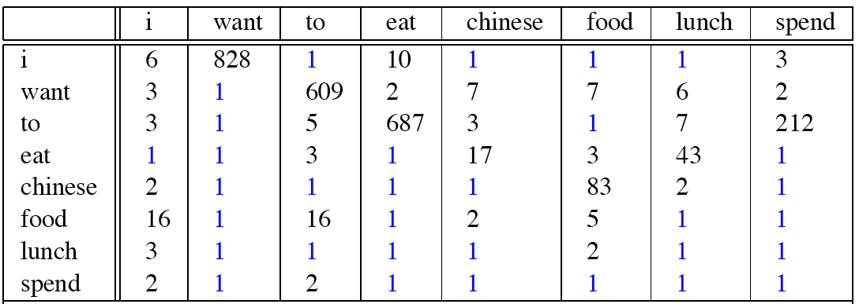
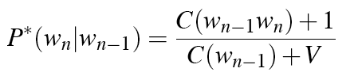
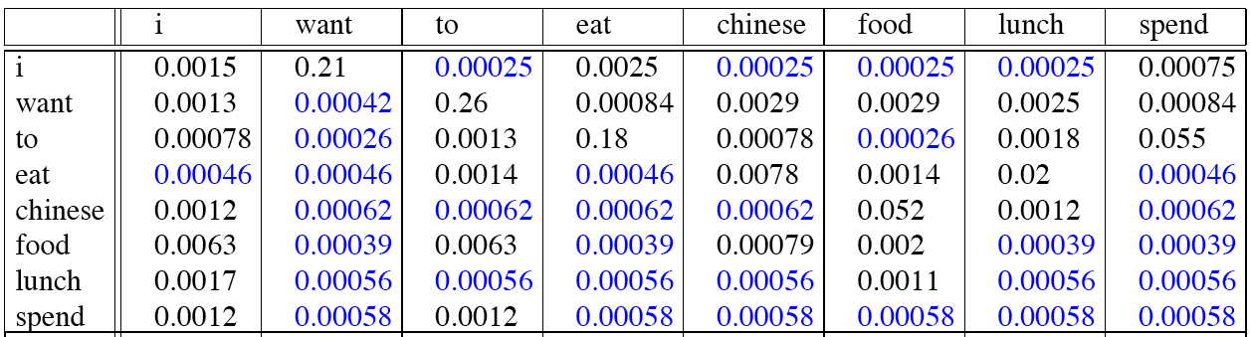
Laplace-Smoothed Bigram Counts
Just add one to all the counts!

Slide 44
Summary
Language models offer a way to assign a probability to a sentence or other sequence of words, and to predict a word from preceding words
n-grams are Markov models that estimate words from a fixed window of previous words.
n-gram probabilities can be estimated by counting in a corpus and normalizing (the maximum likelihood estimate).

Slide 45
NLP TASK | APPLICATION
Morphological parsing | 1- IR(Information Retrieval 2- Machine translation (to realize that the French words va and aller should both translate to forms of the English verb go.) 3-Spelling checking (as we will see, it is morphological knowledge that will tell us that misclam and antiundoggingly are not words)
POS | 1-Speech synthesis(the process of generating spoken language by machine on the basis of written input) 2-Parsing(Need to know if a word is an N or V before you can parse) 3-Information extraction IR 4-Finding names, relations, etc. 5-Machine Translation
N-grams | speech recognition: for example, the input speech sounds are very confusable and many words sound extremely similar. Handwriting recognition: to rob a bank with a written hold-up note that the teller incorrectly reads as “I have a gub”. Any speech and language processing system could avoid making this mistake by using the knowledge that the sequence “I have a gun” is far more probable than the non-word “I have a gub” or even “I have a gull”. Machine translation: translating a Chinese we have a set of potential rough English translations. An N-gram grammar lets us select the bold-faced sentence above as the most fluent translation sentence, i.e. the one that has the highest probability. 3. spellchecker can use a probability estimator both to detect these errors and to suggest higher-probability corrections

Slide 46
Other application N-grams
Text generation (Q\A system and Summerazion)
Chat boot
part-ofspeech tagging,
word similarity
in applications from authorship identification
sentiment extraction to predictive text input systems for cell phones.

Slide 47
Parsing Application
Grammar checkers
Dialogue management
Question answering
Information extraction
Machine translation

Slide 48
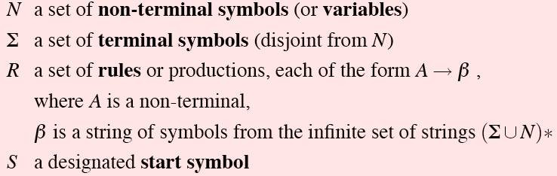
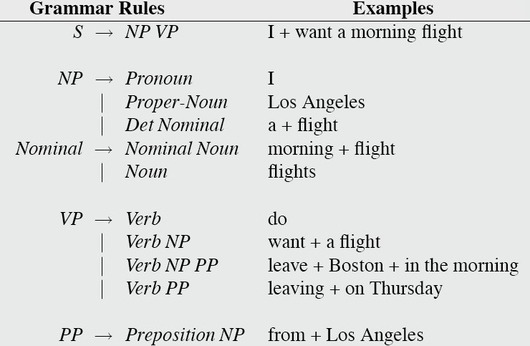
Context-free grammars (CFGs)
Also known as
Phrase structure grammars
Backus-Naur form
Consist of:
Rules(consist of a single non- terminal on the left and any number of terminals and non-terminals on the right
Terminals: called(lexicon (words and symbols)or tokens)
Non-terminals

Slide 49
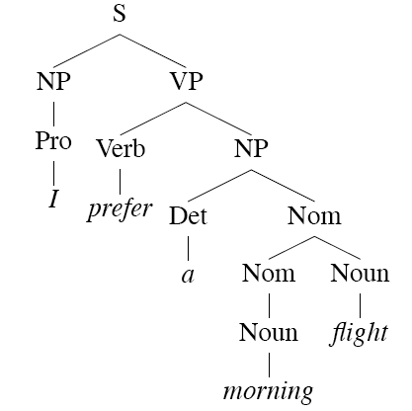
Derivations
A derivation is a sequence of rules applied to a string th accounts for that string
Derivation : This sequence of rule expansions is called a derivation of the string of words.
It is common to represent a derivation by a Parse Tree.
•
•
Show the tree representation of derivation

Slide 50
Parsing
Parsing is the process of taking a string and a grammar and returning a (multiple) parse tree(s) for that string
It is completely analogous to running a finite-state-transducer FST with a tape (It’s just more powerful)
Remember this means that there are languages we can capture with CFGs that we can’t capture with finite-state methods
•
•
•

Slide 51
Parsing with Context-Free Grammars
Parsing with CFGs refers to the task of assigning proper trees to input strings
Proper here means a tree that covers all and only the elements of the input and has an S at the top
Tow Type of Parsing with CFG:
bottom up where you start with the input sentence and try to reach the start symbol
Top down, you start with the starting symbol and try to reach the input sentence by applying
the appropriate rules. Left recursion is a problem. (A → Aa)

Slide 52
structural ambiguity
a new kind of ambiguity, which arises in the syntactic structures used in parsing, called structural ambiguity
occurs when the Structural ambiguity grammar assigns more than one possible parse to a sentence.
We can solve the Structural ambiguity by using PCFG
PCFGs: The probability of some parse of a sentence is then the product of the probabilities of all the rules used.
PCFG = CFG + rule probabilities
S (start symbol)
P (probabilities, one for each rule)
Example:
– P(S → NP VP | S) = 0.8
– P(S → VP | S) = 0.2

Slide 53
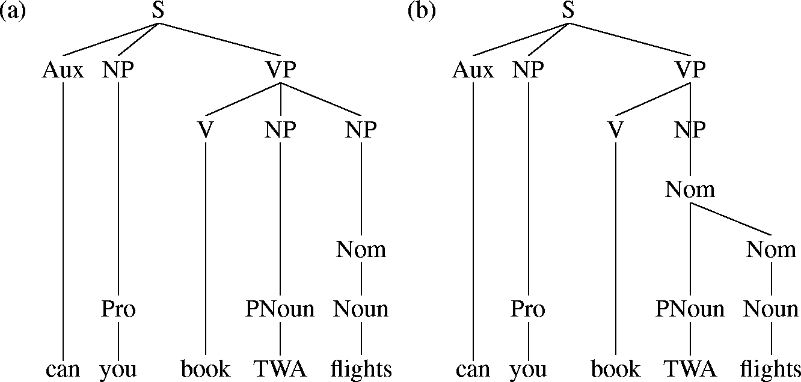
PCFG EXAMPLE
Two parse trees for an ambiguous sentence.
The meaning
Parse (a): 'Can you book flights on behalf of TWA?',
parse (b): 'Can you book flights which are run by TWA'.

Slide 54
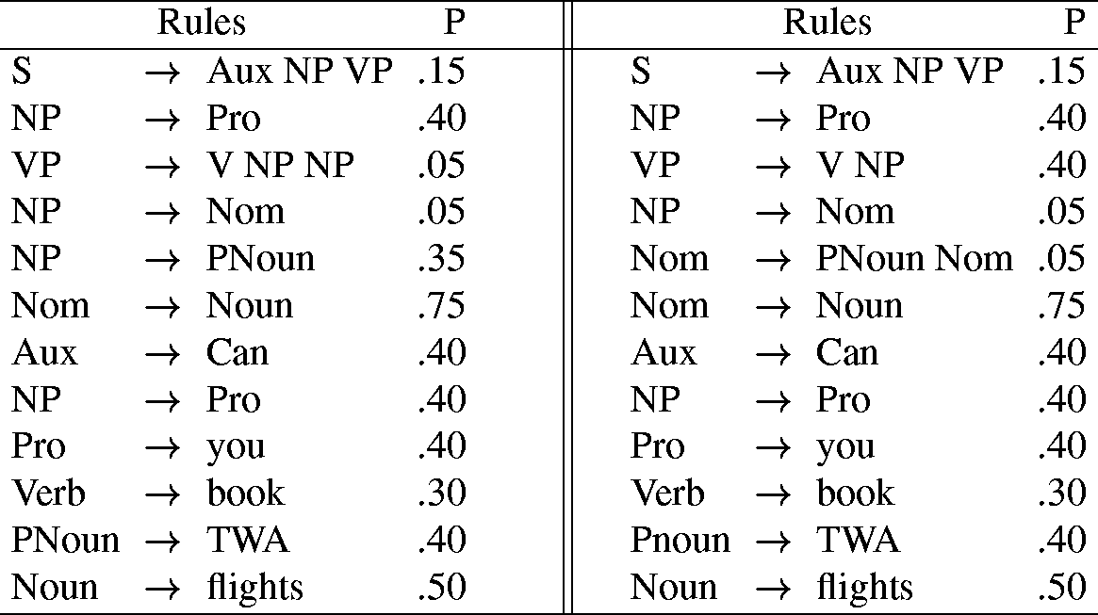
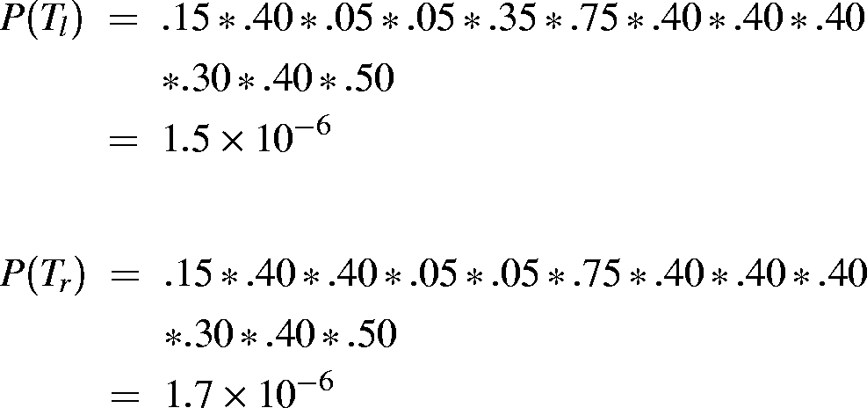

Slide 55
Parsing as Dynamic Programming
Given a problem, systematically fill a table of solutions to sub-problems: this is called memorization.
Once solutions to all sub-problems have been accumulated, solve the overall problem by composing them.
For parsing, the sub-problems are analyses of sub-strings and correspond to constituents that have been found.
Sub-trees are stored in a chart (aka well-formed substring table), which is a record of all the substructures that have ever been built during the parse.
Solves re-parsing problem: sub-trees are looked up, not re-parsed-->
Solves ambiguity problem: chart implicitly stores all parses-->
Both CKY and Earley will result in multiple S structures for the [0,N] table entry.
They both efficiently store the sub-parts that are shared between multiple parses.
And they obviously avoid re-deriving those sub-parts.
But neither can tell us which one is right.

Slide 56
CYK Example
S
S → NP VP VP → V NP NP → NP PP VP → VP PP PP → P NP
NP → Ahmad | Ali | Hail
V → called
P → from
NP
VP
PP
VP
^{V} NP
called Ali
S
_{P} NP
from Hail
Ahmad
NP
VP
NP
N
P
PP
V
called Ali
Ahmad
from
Hail

Slide 57
CYK Example
S → NP VP
VP → V NP
NP → NP PP
VP → VP PP
PP → P NP
NP → Ahmad | Ali | Hail
V → called
P → from
Example: Ahmad called
Ali from
Hail

Slide 58
CYK Example
S₁ S₂ | VP₁ VP₂ | NP | PP | NP
X | X | X | P | Hail
S | VP | NP | from
X | V | Ali
NP | called
Ahmad

Slide 59
Simple PCFG
Lexicon
Grammar Prob
S → NP VP | 0.8 |  | Det → the | a | that | this
S → Aux NP VP | 0.1 | + 1.0 | 0.6 0.2 0.1 0.1
S → VP | 0.1 |  | Noun → book | flight | meal | money
NP → Pronoun | 0.2 |  | 0.1 0.5 0.2 0.2
NP → Proper-Noun | 0.2 | + 1.0 | Verb → book | include | prefer
NP → Det Nominal | 0.6 |  | 0.5 0.2 0.3
Nominal → Noun | 0.3 |  | Pronoun → I | he | she | me
Nominal → Nominal Noun | 0.2 | + 1.0 | 0.5 0.1 0.1 0.3
Nominal → Nominal PP | 0.5 |  | Proper-Noun → Houston | NWA
VP → Verb | 0.2 |  | 0.8 0.2
VP → Verb NP | 0.5 | + 1.0 | Aux → does
VP → VP PP | 0.3 |  | 1.0
PP → Prep NP | 1.0 |  | Prep → from | to | on | near | through
 |  |  | 0.25 0.25 0.1 0.2 0.2

Slide 60
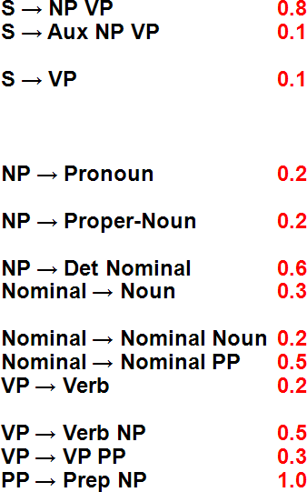
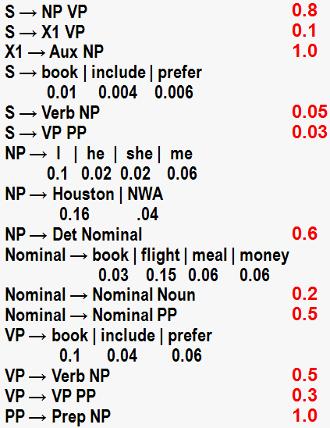
Probabilistic CKY Parser
Book the
flight
through Houston
S :.01, VP:.1,
Verb:.5 Nominal:.03 Noun:.1
S:.05*.5*.054
=.00135
VP:.5*.5*.054
=.0135
S:.03*.0135*
.032
=.00001296
S:.0000216
None
None
NP:.6*.6*.15
=.054
NP:.6*.6*
.0024
=.000864
Det:.6
None
Nominal:.15 Noun:.5
Nominal:
.5*.15*.032
=.0024
None
Prep:.2
PP:1.0*.2*.16
=.032
NP:.16
PropNoun:.8

Slide 61
Probabilistic CKY Parser
Book the
flight
through Houston
S :.01, VP:.1,
Verb:.5 Nominal:.03 Noun:.1
S:.05*.5*.054
=.00135
VP:.5*.5*.054
=.0135
S:.0000216
None
None
NP:.6*.6*.15
=.054
NP:.6*.6*
.0024
=.000864
Det:.6
None
Nominal:.15
Noun:.5
Nominal:
.5*.15*.032
=.0024
Pick most probable parse, i.e. take max to combine probabilities of multiple derivations of each constituent in each cell.
None
Prep:.2
PP:1.0*.2*.16
=.032
NP:.16
PropNoun:.8

Slide 62
Earley Parsing
Allows arbitrary CFGs
Top-down control
Fills a table in a single sweep over the input
Table is length N+1; N is number of words
Table entries represent
Completed constituents and their locations
In-progress constituents
Predicted constituents

Slide 63
States/Locations
S → □ VP [0,0]
A VP is predicted at the start of the sentence
An NP is in progress; the Det goes from 1 to 2
A VP has been found starting at 0 and ending at 3
NP → Det □ Nominal [1,2]
VP → V NP
□ [0,3]

Slide 64
Example CYK Algorithm
Show the CYK Algorithm with the following example:
CNF grammar G
S → AB | BC
A → BA | a
B → CC | b
C → AB | a
w is baaba
Question Is baaba in L(G)?

Slide 65
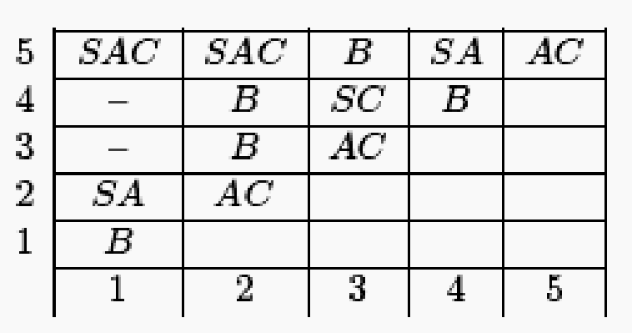
Final Triangular Table
{S, A, C} | ^{← X}1, 5
Ø | {S, A, C}
Ø | {B} | {B}
{S, A} | {B} | {S, C} | {S, A}
{B} | {A, C} | {A, C} | {B} | {A, C}
b | a | a | b | a
Table for string ‘w’ that has length 5
The algorithm populates the triangular table

Slide 66
We define meaning of a word as a vector
Vector semantics is the standard way to represent word meaning in NLP
Called an "embedding" because it's embedded into a space (see textbook)
The standard way to represent meaning in NLP
Every modern NLP algorithm uses embeddings as the representation of word meaning
Fine-grained model of meaning for similarity

Slide 67
Intuition: why vectors?
Consider sentiment analysis:
With words, a feature is a word identity
Feature 5: 'The previous word was "terrible"'
requires exact same word to be in training and test
With embeddings:
Feature is a word vector
'The previous word was vector [35,22,17…]
Now in the test set we might see a similar vector [34,21,14]
We can generalize to similar but unseen words!!!

Slide 68
We'll discuss 2 kinds of embeddings
tf-idf
Information Retrieval workhorse!
A common baseline model
Sparse vectors
Words are represented by (a simple function of) the counts of nearby words
Word2vec
Dense vectors
Representation is created by training a classifier to predict whether a word is likely to appear nearby
Later we'll discuss extensions called contextual embeddings

Slide 69
Term-document matrix
Each document is represented by a vector of words
Notes:
Imagine we have a collection of documents, such as all the works of Shakespeare. We can represent documents in such a collection by a term-document matrix, in which each row represents a word in the vocabulary and each column represents a document from the collection. Here's a small selection from a term-document matrix showing the occurrence of four words in four plays by Shakespeare. Each cell in this matrix represents the number of times a particular word (defined by the row) occurs in a particular document (defined by the column). Thus fool appeared 58 times in Twelfth Night. We can think of each column as a vector representing for a document as a point in |V |-dimensional space; thus the documents in here are points in 4-dimensional space.

Slide 70
More common: word-word matrix (or "term-context matrix")
Two words are similar in meaning if their context vectors are similar
Notes:
An alternative to using the term-document matrix to represent words as vectors of document counts, is to use the term-term matrix, also called the word-word matrix or the term-context matrix, in which the columns are labeled by words rather than documents. This matrix is thus of dimensionality |V | × |V | and each cell records the number of times the row (target) word and the column (context) word co-occur in some context in some training corpus.
The context could be the document, in which case the cell represents the number of times the two words appear in the same document. It is most common, however, to use smaller contexts, generally a window around the word, for example of 4 words to the left and 4 words to the right, in which case the cell represents the number of times (in some training corpus) the column word occurs in such a ±4 word window around the row word. For example here is one example each of some words in their windows with counts from a Wikipedia corpus. Note that digital and information are more similar to each other than, say, to strawberry.

Slide 71
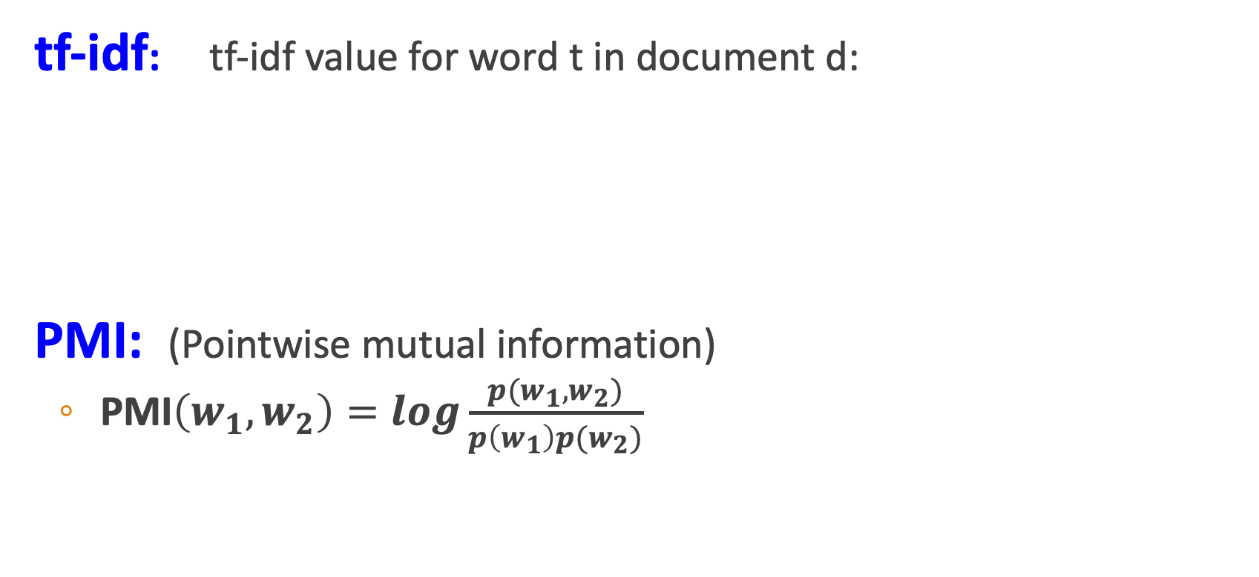
Two common solutions for word weighting
tf-idf: tf-idf value for word t in document d:
PMI: (Pointwise mutual information)
$\text{PMI}\left(w_{1},w_{2}\right)=log\frac{p(w_{1},w_{2})}{p\left(w_{1}\right)p(w_{2})}$
Words like "the" or "it" have very low idf
See if words like "good" appear more often with "great" than we would expect by chance
Notes:
There are two common solutions to this problem: the tf-idf algorithm, usually used when the dimensions are documents, and algorithms based on pointwise mutual information, or PMI (usually used when the dimensions are words). Tf-idf makes use of a special weight call the "inverse document frequency or "idf", to downweight words like "the" or "it". PMI is a statistical measure that compares the probabilities we see with what we would have expected by change.

Slide 72
Inverse document frequency (idf)
N is the total number of documents
in the collection
Notes:
We emphasize discriminative words like Romeo via the inverse document fre- quency or idf term weight (Sparck Jones, 1972). The idf is defined using the frac- tion N/dft, where N is the total number of documents in the collection, and dft is the number of documents in which term t occurs. The fewer documents in which a term occurs, the higher this weight. The lowest weight of 1 is assigned to terms that occur in all the documents. Because of the large number of documents in many collections, this measure too is usually squashed with a log function. The resulting definition for inverse document frequency (idf) is thus
Here are some idf values for some words in the Shakespeare corpus, ranging from extremely informative words which occur in only one play like Romeo, to those that occur in a few like salad or Falstaff, to those which are very common like fool or so common as to be completely non-discriminative since they occur in all 37 plays like good or sweet.

Slide 73
Final tf-idf weighted value for a word
Raw counts:
tf-idf:
Notes:
The tf-idf weighted value wt,d for word t in document d thus combines term
frequency tft,d with idf:
Here's the raw counts in the Shakespeare term-document matrix, and the tf-idf weighted version of the same matrix.. Note that the tf-idf values for the dimension corresponding to the word good have now all become 0; since this word appears in every document, the tf-idf algorithm leads it to be ignored. Similarly, the word fool, which appears in 36 out of the 37 plays, has a much lower weight.

Slide 74
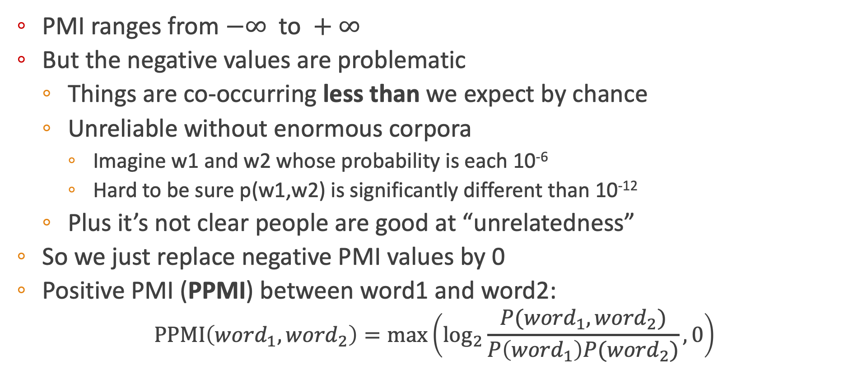
Positive Pointwise Mutual Information
PMI ranges from $−∞ \text{to} +∞$
But the negative values are problematic
Things are co-occurring less than we expect by chance
Unreliable without enormous corpora
Imagine w1 and w2 whose probability is each 10⁻⁶
Hard to be sure p(w1,w2) is significantly different than 10⁻¹²
Plus it’s not clear people are good at “unrelatedness”
So we just replace negative PMI values by 0
Positive PMI (PPMI) between word1 and word2:
$$\text{PPMI}\left({word}_{1}, {word}_{2}\right)=\max\left({\text{log}}_{2}\frac{P({word}_{1}, {word}_{2})}{P\left({word}_{1}\right)P({word}_{2})},0\right)$$

Slide 75
Cosine examples
 | pie | data | computer
cherry | 442 | 8 | 2
digital | 5 | 1683 | 1670
information | 5 | 3982 | 3325
Notes:
Let’s see how the cosine computes which of the words cherry or digital is closer in meaning to information, just using raw counts from the following shortened table.
The model decides that information is way closer to digital than it is to cherry, a result that seems sensible.

Slide 76
Sparse versus dense vectors
tf-idf (or PMI) vectors are
long (length |V|= 20,000 to 50,000)
sparse (most elements are zero)
Alternative: learn vectors which are
short (length 50-1000)
dense (most elements are non-zero)
Notes:
In the previous lectures we saw how to represent a word as a sparse, long vector with dimensions corresponding to words in the vocabulary or documents in a collection. We now introduce a more powerful word representation: embeddings, short dense vectors. Unlike the vectors we’ve seen so far, embeddings are short, with number of dimensions d ranging from 50-1000, rather than the much larger vocabulary size |V | or number of documents D we’ve seen. These d dimensions don’t have a clear interpretation. And the vectors are dense: instead of vector entries being sparse, mostly-zero counts or functions of counts, the values will be real-valued numbers that can be negative.

Slide 77
Sparse versus dense vectors
Why dense vectors?
Short vectors may be easier to use as features in machine learning (fewer weights to tune)
Dense vectors may generalize better than explicit counts
Dense vectors may do better at capturing synonymy:
car and automobile are synonyms; but are distinct dimensions
a word with car as a neighbor and a word with automobile as a neighbor should be similar, but aren't
In practice, they work better
Notes:
It turns out that dense vectors work better in every NLP task than sparse vectors. While we don’t completely understand all the reasons for this, we have some intu- itions. Representing words as 700-dimensional dense vectors requires our classifiers to learn far fewer weights than if we represented words as 50,000-dimensional vec- tors, and the smaller parameter space possibly helps with generalization and avoid- ing overfitting. Dense vectors may also do a better job of capturing synonymy. For example, in a sparse vector representation, dimensions for synonyms like car and automobile dimension are distinct and unrelated; sparse vectors may thus fail to capture the similarity between a word with car as a neighbor and a word with automobile as a neighbo

Slide 78
Word2vec
Popular embedding method
Very fast to train
Code available on the web
Idea: predict rather than count
Word2vec provides various options. We'll do:
skip-gram with negative sampling (SGNS)

Slide 79
Skip-Gram Training data
…lemon, a [tablespoon of apricot jam, a] pinch…
c1 c2 [target] c3 c4
Notes:
Skip-gram learns embeddings by starting with random embedding vectors and then iteratively shifting the embedding of each word w to be more like the embeddings of words that occur nearby in texts, and less like the embeddings of words that don’t occur nearby. Let’s start by considering a single piece of training data
This example has a target word w (apricot), and 4 context words in the L = ±2 window, resulting in 4 positive training instances (on the left below):

Slide 80
Skip-Gram Training data
…lemon, a [tablespoon of apricot jam, a] pinch…
c1 c2 [target] c3 c4
For each positive example we'll grab k negative examples, sampling by frequency
Notes:
For training a binary classifier we also need negative examples. In fact skip- gram with negative sampling (SGNS) uses more negative examples than positive examples (with the ratio between them set by a parameter k). So for each of these (w,cpos) training instances we’ll create k negative samples, each consisting of the target w plus a ‘noise word’ cneg. A noise word is a random word from the lexicon, constrained not to be the target word w.

Slide 81
Skip-Gram Training data
…lemon, a [tablespoon of apricot jam, a] pinch…
c1 c2 [target] c3 c4
Notes:
Here's the setting where k = 2, so we’ll have 2 negative examples in the negative training set − for each positive example w,cpos. The noise words are chosen according to their weighted unigram frequency.

Slide 82
